Slide 1


UNIT 5: Me and the World
A day in bed

Slide 2
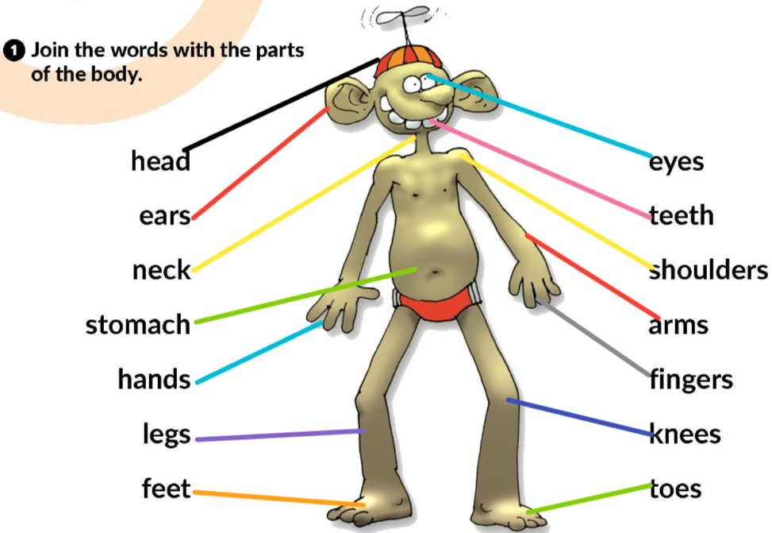
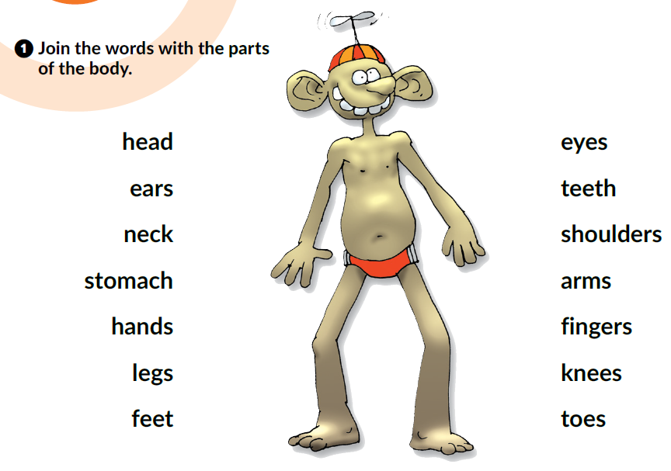
Let’s play Simon says.
Listen to your teacher and show the correct body part.
(e.g. Simon says, touch your nose.)

Slide 3
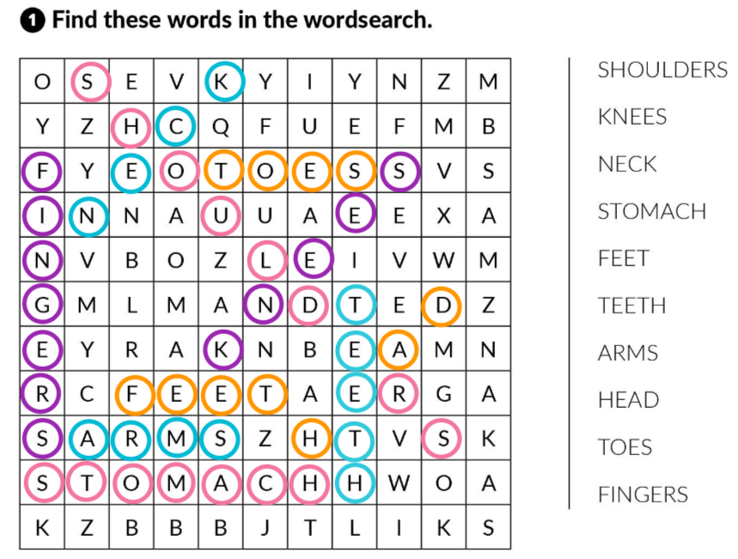
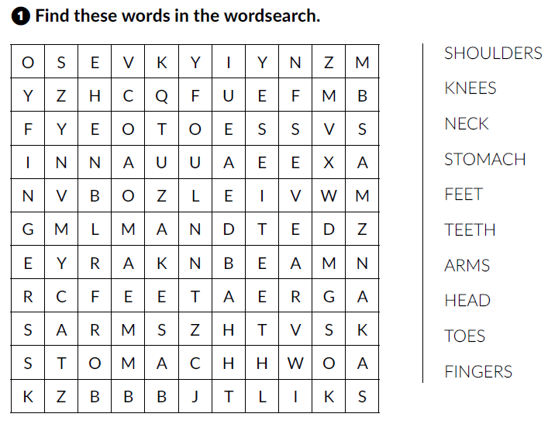
Workbook p. 58.

Slide 4
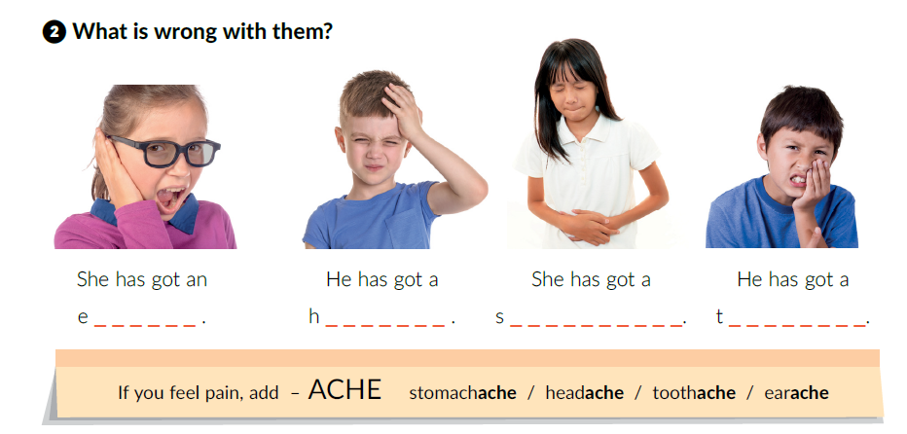

Textbook, p. 82.
arache
eadache
tomachache
oothache
Click on the following link and choose Learn more: Common health problems and what to do. Can you find two extra illnesses that are mentioned in the text.
https://www.e-sfera.hr/dodatni-digitalni-sadrzaji/16e7a7f9-3d62-4b8d-aa88-6858b294e227/

Slide 5
Read the text Common health problems and what to do again and answer the questions below the text.
https://www.e-sfera.hr/dodatni-digitalni-sadrzaji/16e7a7f9-3d62-4b8d-aa88-6858b294e227/
Let’s play!
Think of an illness that is mentioned in the text and mime. Your classmates have to name the illness.

Slide 6
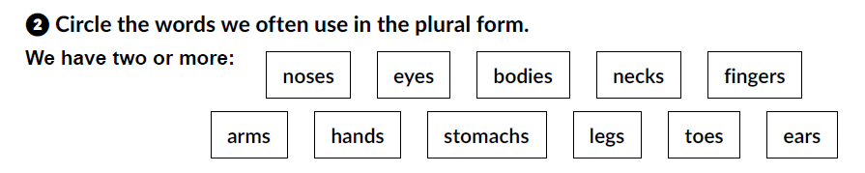
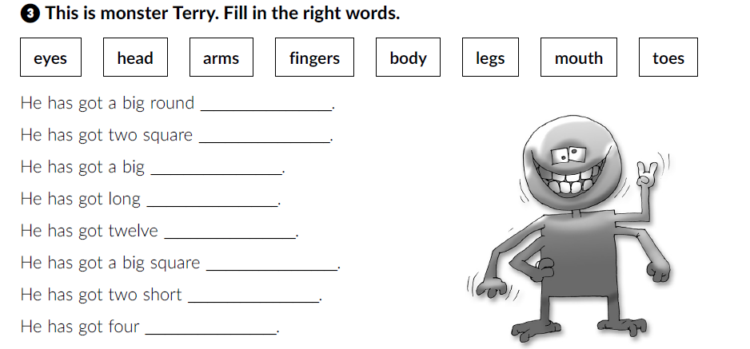
Workbook, p. 56 and 57.
head
eyes
head
arms
fingers
body
legs
toes

Slide 7
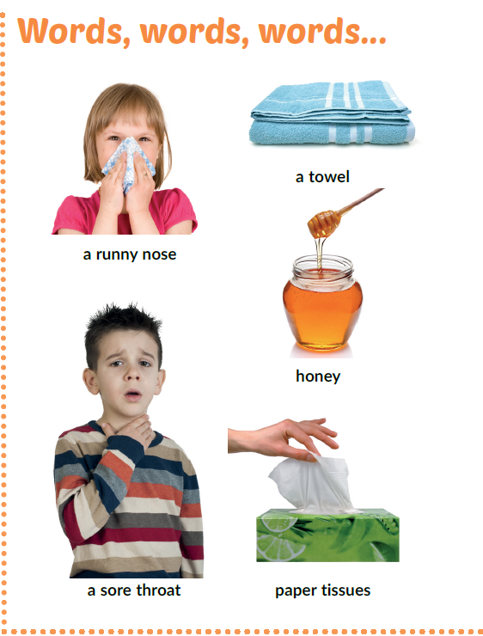
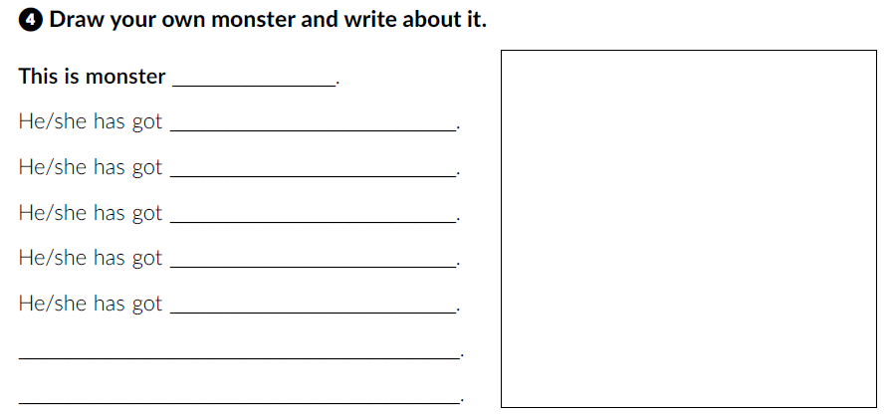
Textbook, p. 83.
What do the words mean?

Slide 8

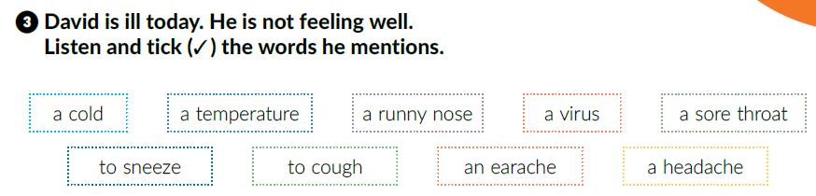
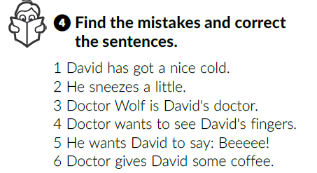
Listen and tick (✓) the words he mentions.
✓
✓
✓
✓
✓
✓
Listen and correct the sentences.
bad
lot
Fox
throat
Aaaaah!
syrup

Slide 9
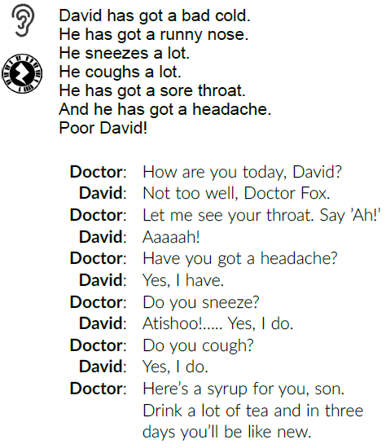
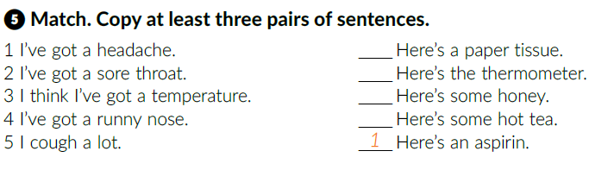
Work in pairs. Read the dialogue out loud.
4
3
5
2

Slide 10
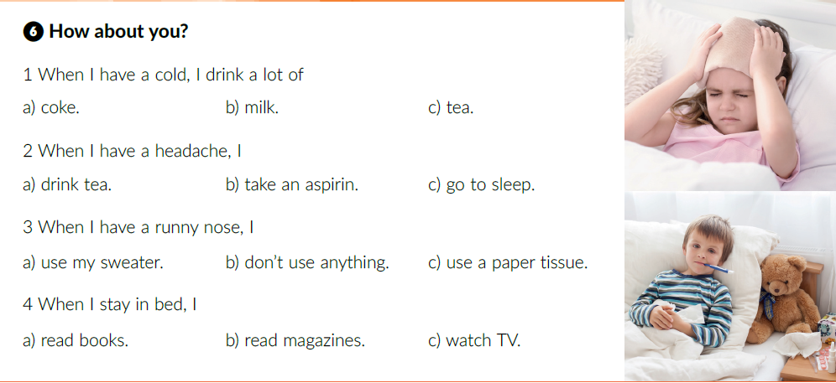

Slide 11
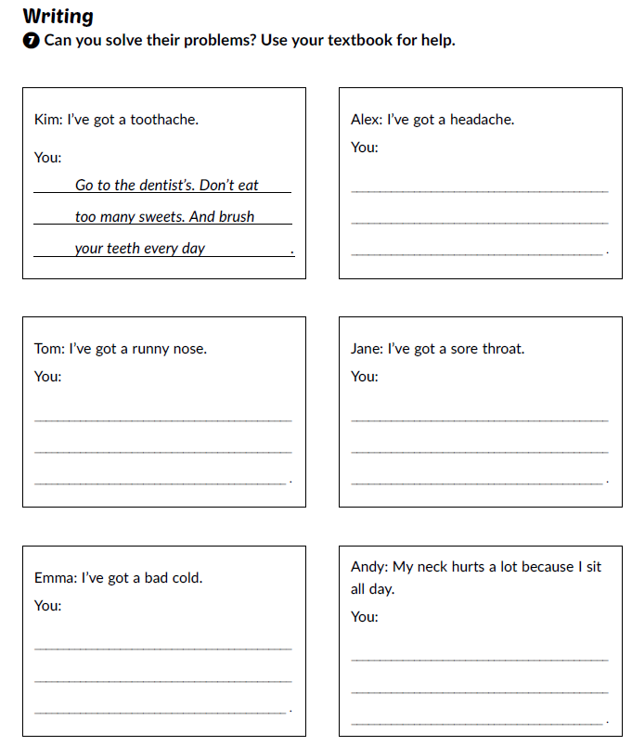
Workbook, p. 58.

Slide 12

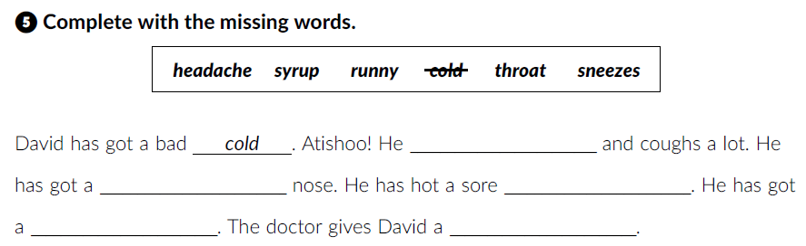
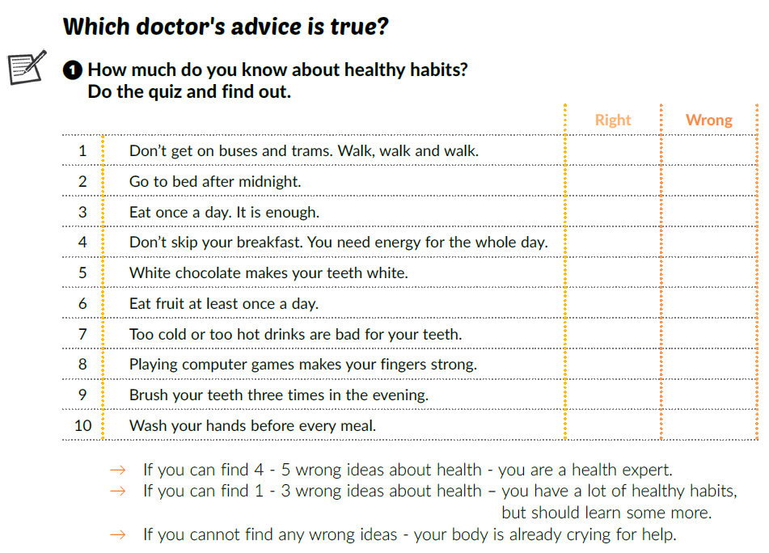
Textbook, p. 86.
Workbook, p. 57.
sneezes
✓
runny
throat
✓
headache
syrup
✓
✓
✓
✓
✓
✓
✓
✓

Slide 13
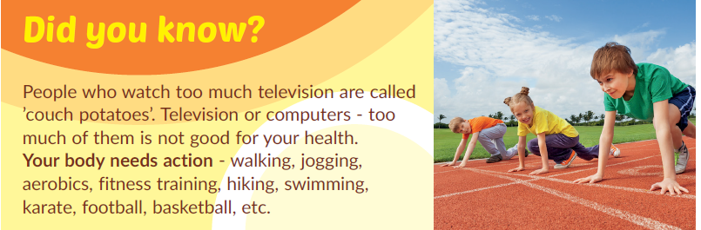
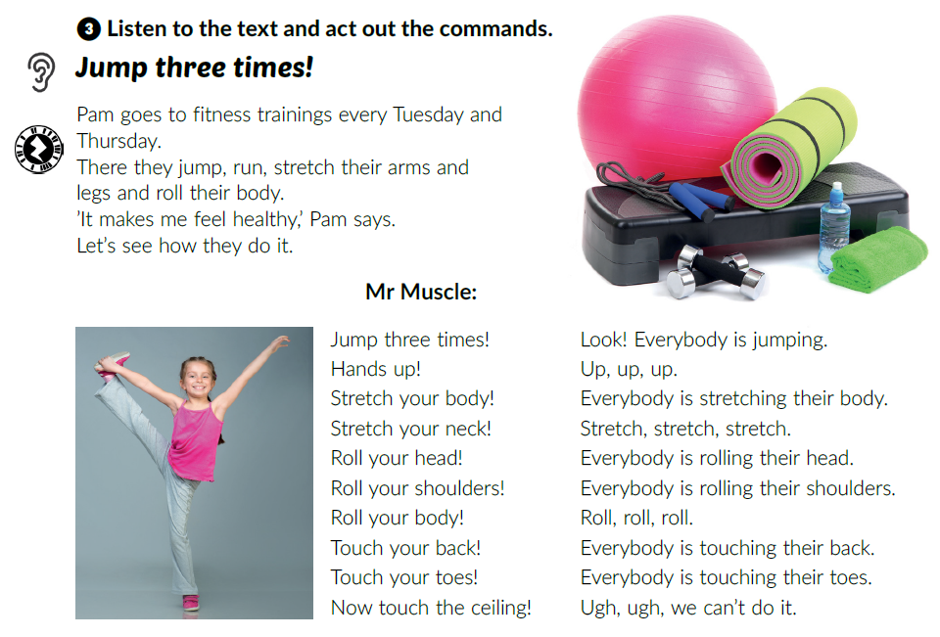
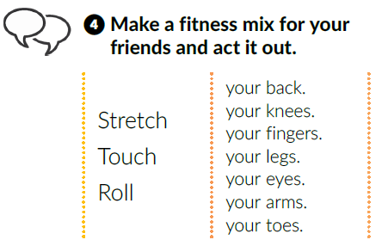
Who are ‘’couch potatoes’’?

Slide 14
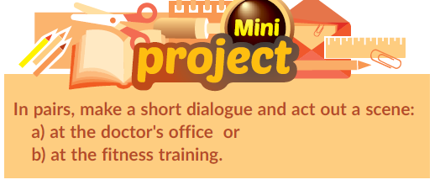
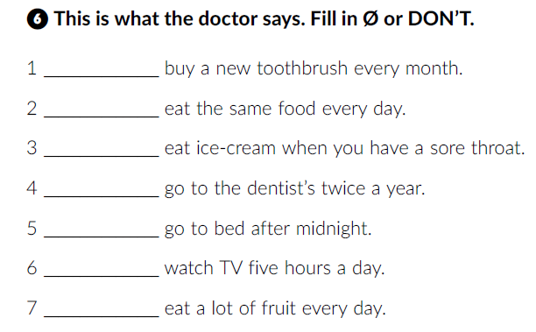
Work in pairs or small groups.
Workbook, p. 57.
/
Don’t
Click on the following link and choose Self check. Complete the tasks.
https://www.e-sfera.hr/dodatni-digitalni-sadrzaji/16e7a7f9-3d62-4b8d-aa88-6858b294e227/
Don’t
/
Don’t
Don’t
/

